Slide 1
CLUSTERING
K – MEANS & HIERARCHICAL CLUSTERING

Slide 2
Project brief
The data collected on the basis of past year deals was used to cluster clients based on the quantity of purchase done by them annually.
This allowed to cluster clients on the basis of Annual Order quantity purchased.
Business Objective:
The primary business objective is to segment the customers into distinct clusters based on their annual order quantity purchase and spending score. The identified clusters will help the company understand the preferences and requirements of different customer segments and design targeted marketing strategies to attract and retain customers from each group.

Slide 3
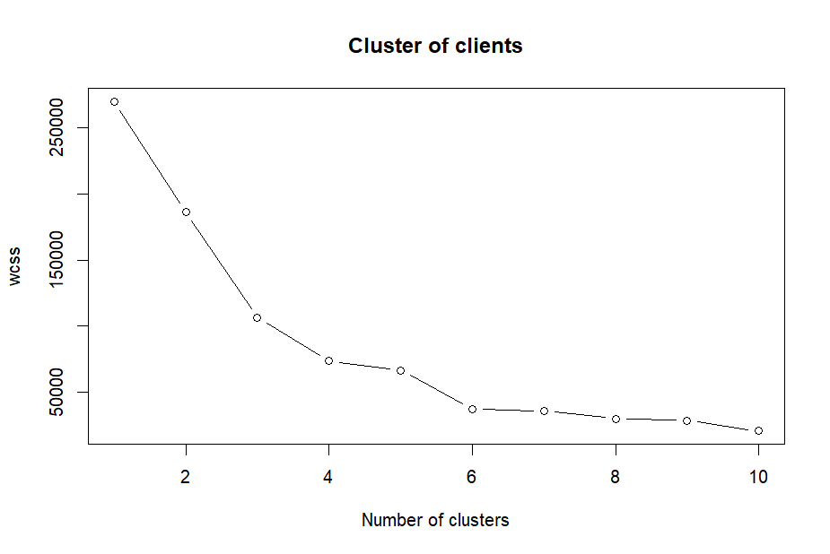
ELBOW METHOD

Slide 4
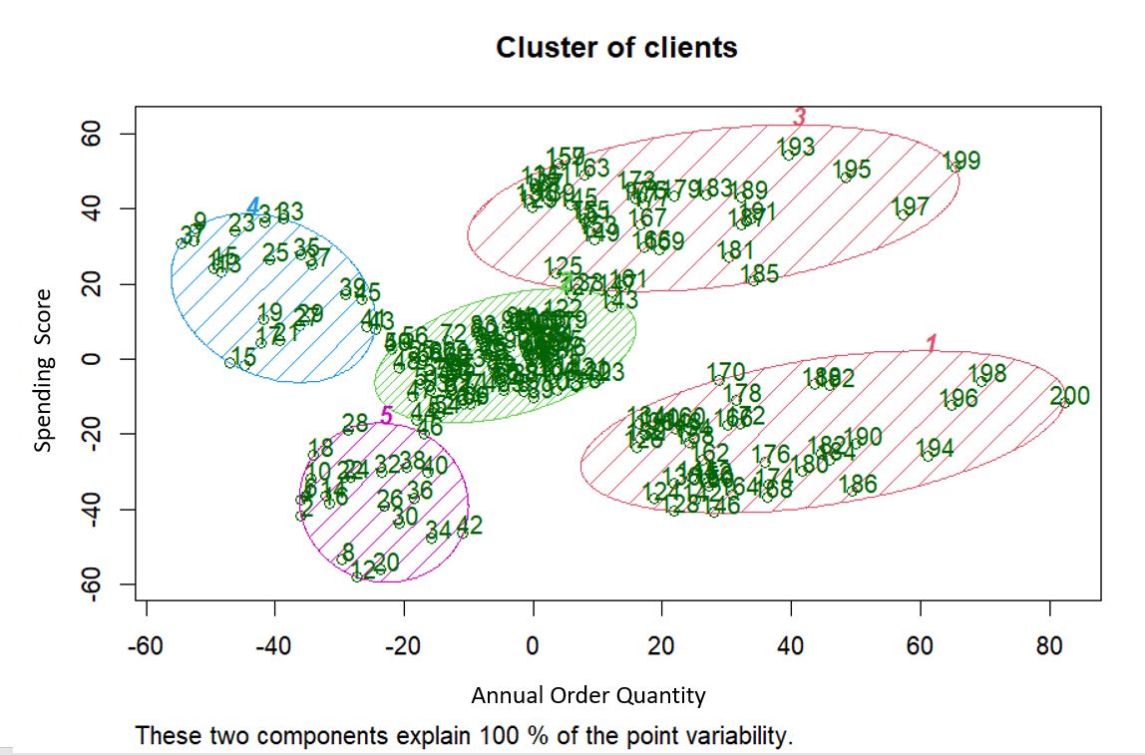
K - MEANS

Slide 5
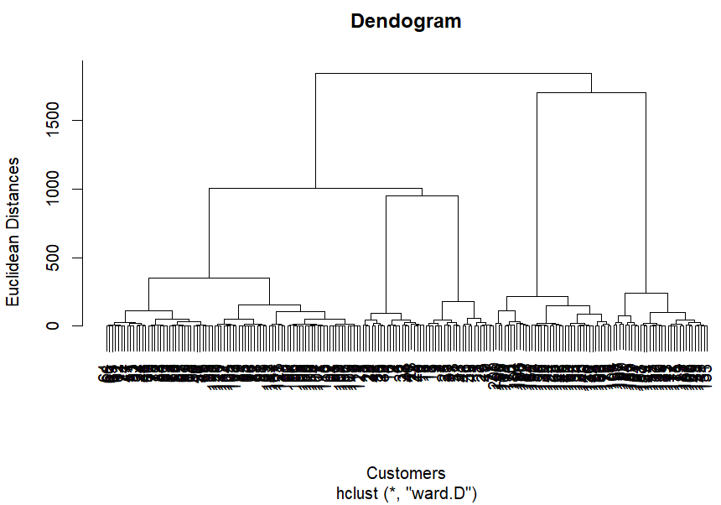
DENDOGRAM
CUT-OFF POINT FOR CLUSTER FORMATION

Slide 6
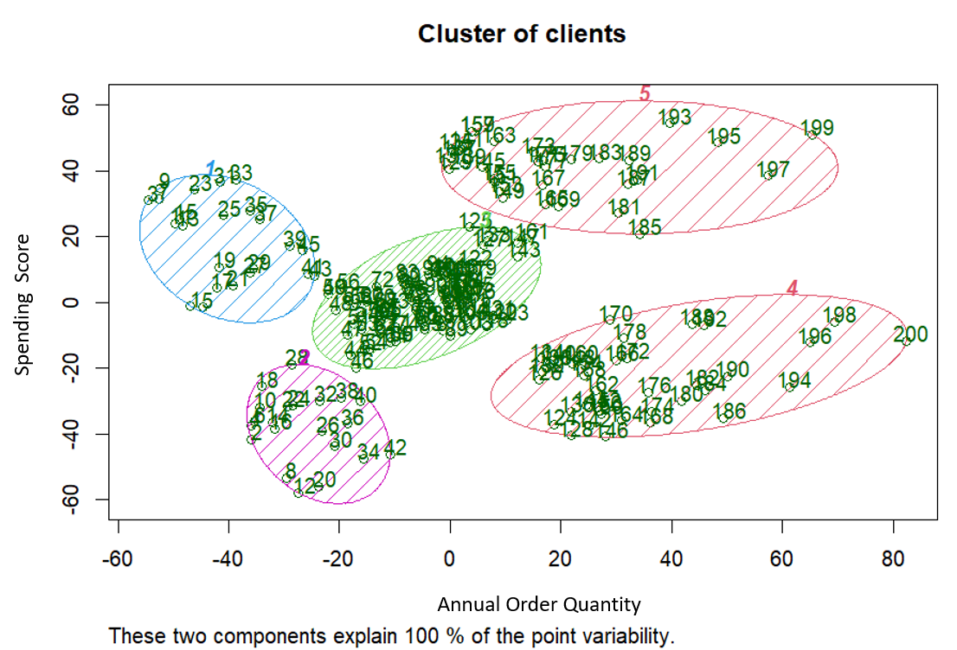
HIERARCHICAL CLUSTERING

